Slide 1
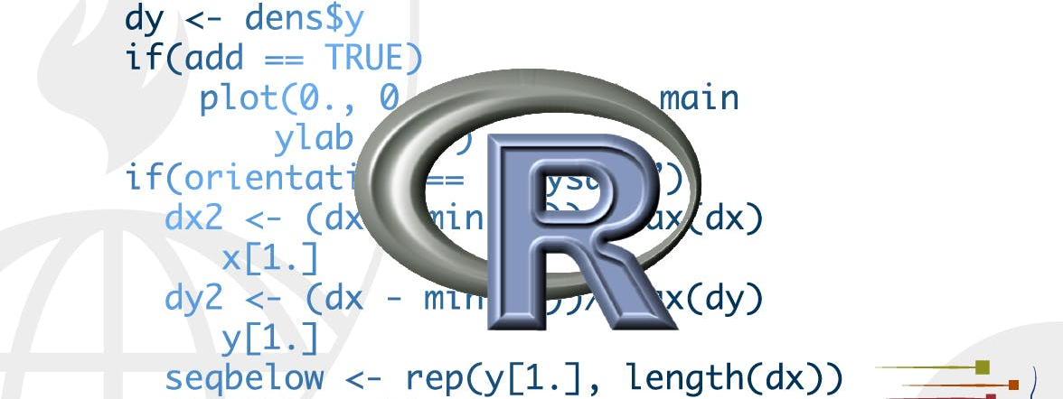
strings
STA 4233 Introduction to Programming and Data Management in R
Notes:
This lecture introduces you to string manipulation in R. You’ll learn the basics of how strings work and how to create them by hand, but the focus of this chapter will be on regular expressions, or regexps for short. Regular expressions are useful because strings usually contain unstructured or semi-structured data, and regexps are a concise language for describing patterns in strings. When you first look at a regexp, you’ll think a cat walked across your keyboard, but as your understanding improves they will soon start to make sense.

Slide 2
String basics
You can create strings with either single quotes or double quotes
If you forget to close a quote, you’ll see +, the continuation character:
string1 <- "This is a string"
string2 <- 'If I want to include a "quote" inside a string, I use single quotes'
> "This is a string without a closing quote
+
+
+ HELP I'M STUCK
ESC
Notes:
You can create strings with either single quotes or double quotes. Unlike other languages, there is no difference in behaviour. I recommend always using ", unless you want to create a string that contains multiple ".
If you forget to close a quote, you’ll see +, the continuation character:
If this happen to you, press Escape and try again!

Slide 3
String basics
To include a literal single or double quote in a string you can use \ to “escape” it:
That means if you want to include a literal backslash, you’ll need to double it up: "\\".
double_quote <- "\"" # or '“’
single_quote <- '\'' # or "'"
Notes:
To include a literal single or double quote in a string you can use \ to “escape” it:
That means if you want to include a literal backslash, you’ll need to double it up: "\\".

Slide 4
Use writelines() to see the contents
x <- c("\"", "\\")
x
#> [1] "\"" "\\"
writeLines(x)
#> "
#> \
Notes:
Beware that the printed representation of a string is not the same as string itself, because the printed representation shows the escapes. To see the raw contents of the string, use writeLines():

Slide 5
other special characters
\n newline
\t tab
For a complete list type ?'"', or ?“’”.
There are also non-English characters
x <- "\u00b5"
x
#> [1] "µ"
Notes:
There are a handful of other special characters. The most common are "\n", newline, and "\t", tab, but you can see the complete list by requesting help on ": ?'"', or ?"'". You’ll also sometimes see strings like "\u00b5", this is a way of writing non-English characters that works on all platforms:

Slide 6
Multiple strings
Multiple strings are often stored in a character vector, which you can create with c():
c("one", "two", "three")
#> [1] "one" "two" "three"
Notes:
Multiple strings are often stored in a character vector, which you can create with c():

Slide 7

String length
str_length(c("a", "R for data science", NA))
#> [1] 1 18 NA
Notes:
Base R contains many functions to work with strings but we’ll avoid them because they can be inconsistent, which makes them hard to remember. Instead we’ll use functions from stringr. These have more intuitive names, and all start with str_. For example, str_length() tells you the number of characters in a string:

Slide 8
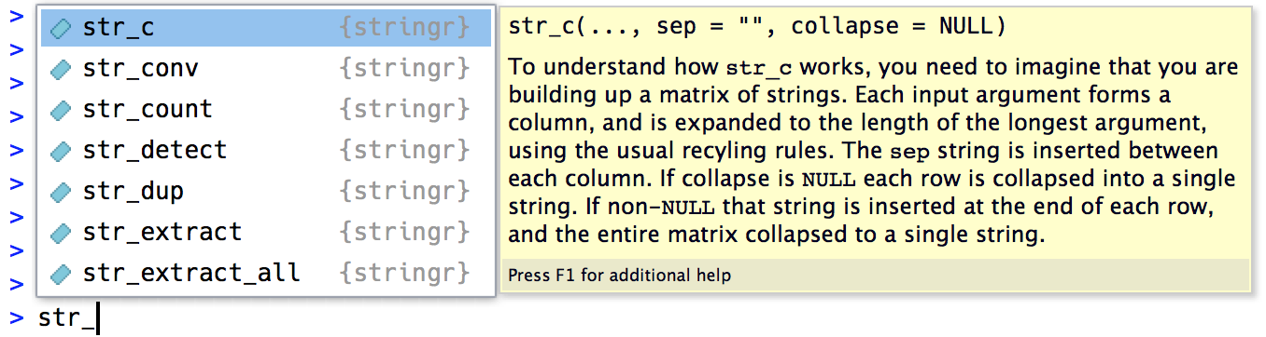
all stringr functions in Rstudio
Notes:
The common str_ prefix is particularly useful if you use RStudio, because typing str_ will trigger autocomplete, allowing you to see all stringr functions:

Slide 9
Combining strings
To combine two or more strings, use str_c():
Use the sep argument to control how they’re separated:
str_c("x", "y")
#> [1] "xy"
str_c("x", "y", "z")
#> [1] "xyz"
str_c("x", "y", sep = ", ")
#> [1] "x, y"
Notes:
To combine two or more strings, use str_c():
Use the sep argument to control how they’re separated:

Slide 10
Missing value contagion
x <- c("abc", NA)
str_c("|-", x, "-|")
#> [1] "|-abc-|" NA
str_c("|-", str_replace_na(x), "-|")
#> [1] "|-abc-|" "|-NA-|"
Notes:
Like most other functions in R, missing values are contagious. If you want them to print as "NA", use str_replace_na():

Slide 11
Str_c() is vectorized
str_c("prefix-", c("a", "b", "c"), "-suffix")
#> [1] "prefix-a-suffix" "prefix-b-suffix" "prefix-c-suffix"
Notes:
As shown above, str_c() is vectorised, and it automatically recycles shorter vectors to the same length as the longest:

Slide 12
String basics
name <- “Joey"
time_of_day <- “evening"
birthday <- FALSE
str_c(
"Good ", time_of_day, " ", name,
if (birthday) " and HAPPY BIRTHDAY", "."
)
#> [1] "Good evening Joey."
Notes:
Objects of length 0 are silently dropped. This is particularly useful in conjunction with if:

Slide 13
collapse
str_c(c("x", "y", "z"), collapse = ", ")
#> [1] "x, y, z"
Notes:
To collapse a vector of strings into a single string, use collapse:

Slide 14
Subsetting strings
x <- c("Apple", "Banana", "Pear")
str_sub(x, 1, 3)
#> [1] "App" "Ban" "Pea"
# negative numbers count backwards from end
str_sub(x, -3, -1)
#> [1] "ple" "ana" "ear"
str_sub("a", 1, 5)
#> [1] "a"
str_sub(x, 1, 1) <- str_to_lower(str_sub(x, 1, 1))
x
#> [1] "apple" "banana" "pear"
Notes:
You can extract parts of a string using str_sub(). As well as the string, str_sub() takes start and end arguments which give the (inclusive) position of the substring:
Note that str_sub() won’t fail if the string is too short: it will just return as much as possible:
You can also use the assignment form of str_sub() to modify strings:

Slide 15
Locales
# Turkish has two i's: with and without a dot, and it
# has a different rule for capitalising them:
str_to_upper(c("i", "ı"))
#> [1] "I" "I"
str_to_upper(c("i", "ı"), locale = "tr")
#> [1] "İ" "I"
https://en.wikipedia.org/wiki/List_of_ISO_639-1_codes
Notes:
Above I used str_to_lower() to change the text to lower case. You can also use str_to_upper() or str_to_title(). However, changing case is more complicated than it might at first appear because different languages have different rules for changing case. You can pick which set of rules to use by specifying a locale:
The locale is specified as a ISO 639 language code, which is a two or three letter abbreviation. If you don’t already know the code for your language, Wikipedia has a good list. If you leave the locale blank, it will use the current locale, as provided by your operating system.

Slide 16
locales
x <- c("apple", "eggplant", "banana")
str_sort(x, locale = "en") # English
#> [1] "apple" "banana" "eggplant"
str_sort(x, locale = "haw") # Hawaiian
#> [1] "apple" "eggplant" "banana"
Notes:
Another important operation that’s affected by the locale is sorting. The base R order() and sort() functions sort strings using the current locale. If you want robust behaviour across different computers, you may want to use str_sort() and str_order() which take an additional locale argument:

Slide 17
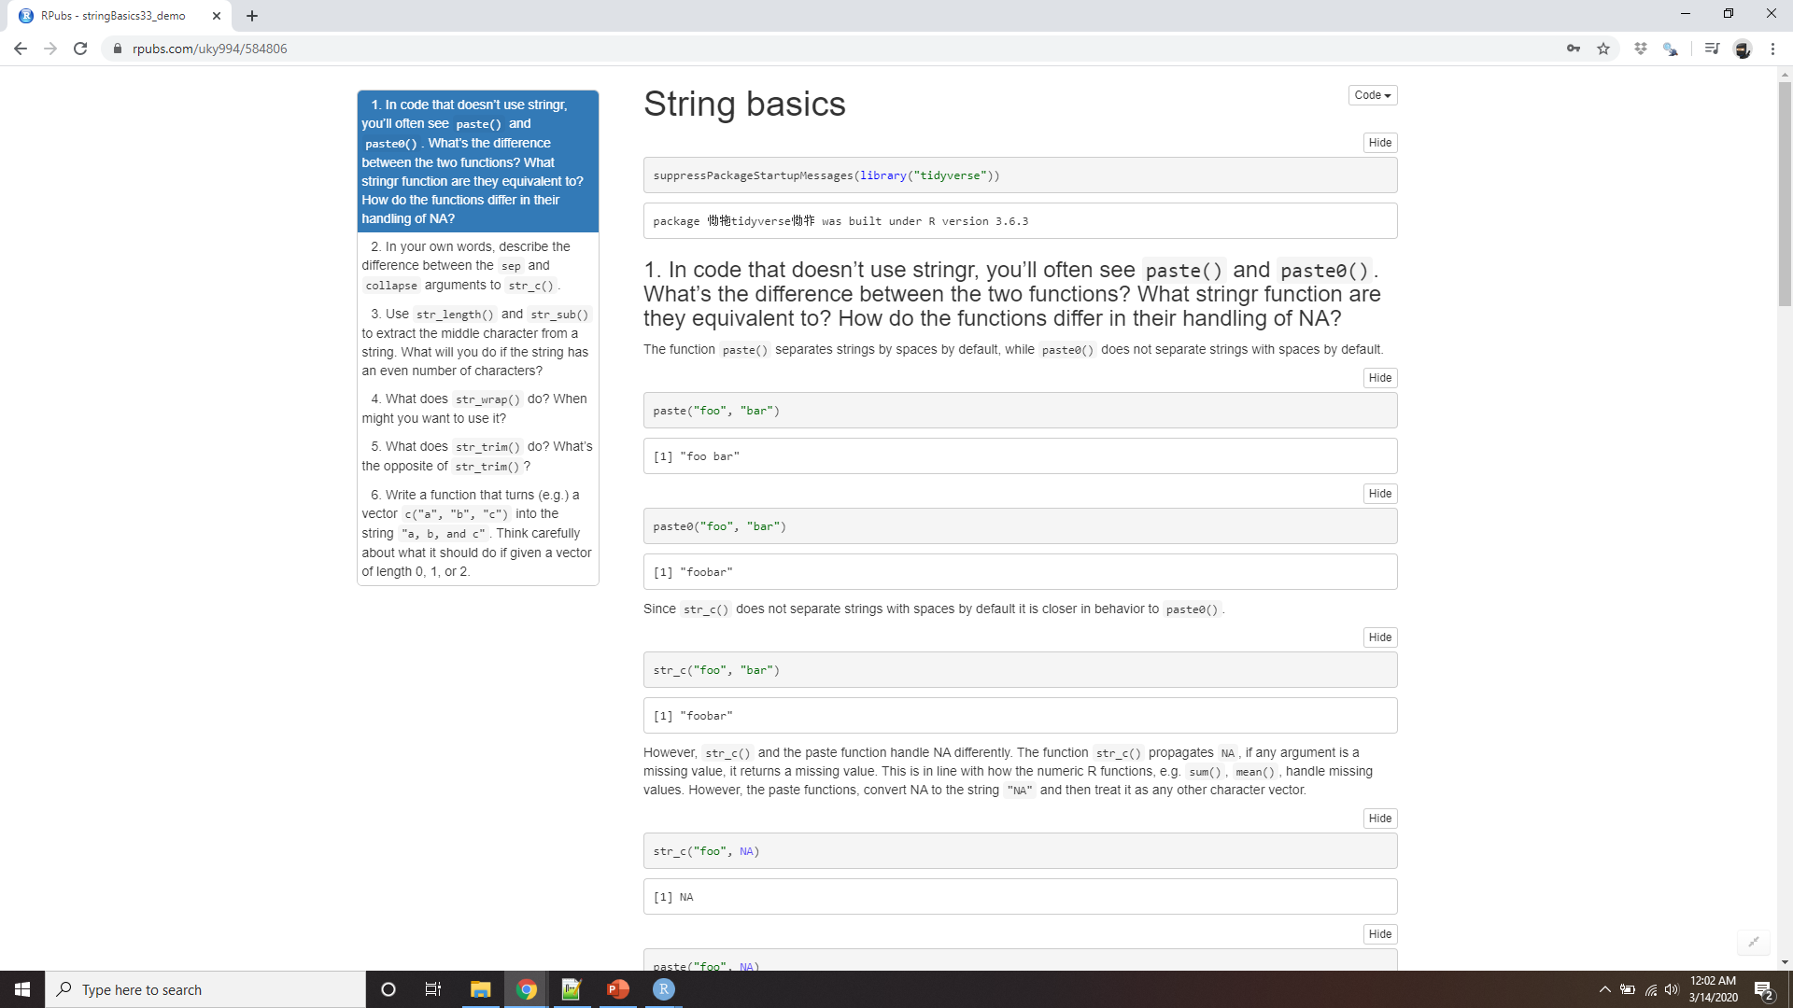
Demo String basics
Notes:
https://rpubs.com/uky994/584806
In code that doesn’t use stringr, you’ll often see paste() and paste0(). What’s the difference between the two functions? What stringr function are they equivalent to? How do the functions differ in their handling of NA?
In your own words, describe the difference between the sep and collapse arguments to str_c().
Use str_length() and str_sub() to extract the middle character from a string. What will you do if the string has an even number of characters?
What does str_wrap() do? When might you want to use it?
What does str_trim() do? What’s the opposite of str_trim()?
Write a function that turns (e.g.) a vector c("a", "b", "c") into the string a, b, and c. Think carefully about what it should do if given a vector of length 0, 1, or 2.

Slide 18
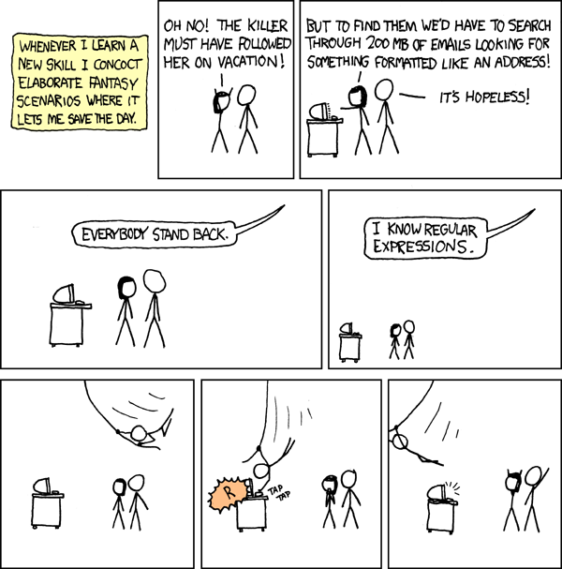
Matching patterns with regular expressions
Notes:
Regexps are a very terse language that allow you to describe patterns in strings. They take a little while to get your head around, but once you understand them, you’ll find them extremely useful.
To learn regular expressions, we’ll use str_view() and str_view_all(). These functions take a character vector and a regular expression, and show you how they match. We’ll start with very simple regular expressions and then gradually get more and more complicated. Once you’ve mastered pattern matching, you’ll learn how to apply those ideas with various stringr functions.

Slide 19
Basic matches
The simplest patterns match exact strings:
The next step up in complexity is ., which matches any character (except a newline):
x <- c("apple", "banana", "pear")
str_view(x, "an")
apple
banana
pear
str_view(x, ".a.")
apple
banana
pear
Notes:
The simplest patterns match exact strings:
x <- c("apple", "banana", "pear") str_view(x, "an")
apple
banana
pear
The next step up in complexity is ., which matches any character (except a newline):
str_view(x, ".a.")
apple
banana
pear

Slide 20
how do you match the character “.”?
# To create the regular expression, we need \\
dot <- "\\."
# But the expression itself only contains one:
writeLines(dot)
#> \.
# And this tells R to look for an explicit .
str_view(c("abc", "a.c", "bef"), "a\\.c")
abc
a.c
bef
Notes:
But if “.” matches any character, how do you match the character “.”? You need to use an “escape” to tell the regular expression you want to match it exactly, not use its special behaviour. Like strings, regexps use the backslash, \, to escape special behaviour. So to match an ., you need the regexp \.. Unfortunately this creates a problem. We use strings to represent regular expressions, and \ is also used as an escape symbol in strings. So to create the regular expression \. we need the string "\\.".

Slide 21
how do you match a literal \?
x <- "a\\b"
writeLines(x)
#> a\b
str_view(x, "\\\\")
I’ll write regular expression as \. and strings that represent the regular expression as "\\.".
Notes:
If \ is used as an escape character in regular expressions, how do you match a literal \? Well you need to escape it, creating the regular expression \\. To create that regular expression, you need to use a string, which also needs to escape \. That means to match a literal \ you need to write "\\\\" — you need four backslashes to match one!
In this course, I’ll write regular expression as \. and strings that represent the regular expression as "\\.".

Slide 22
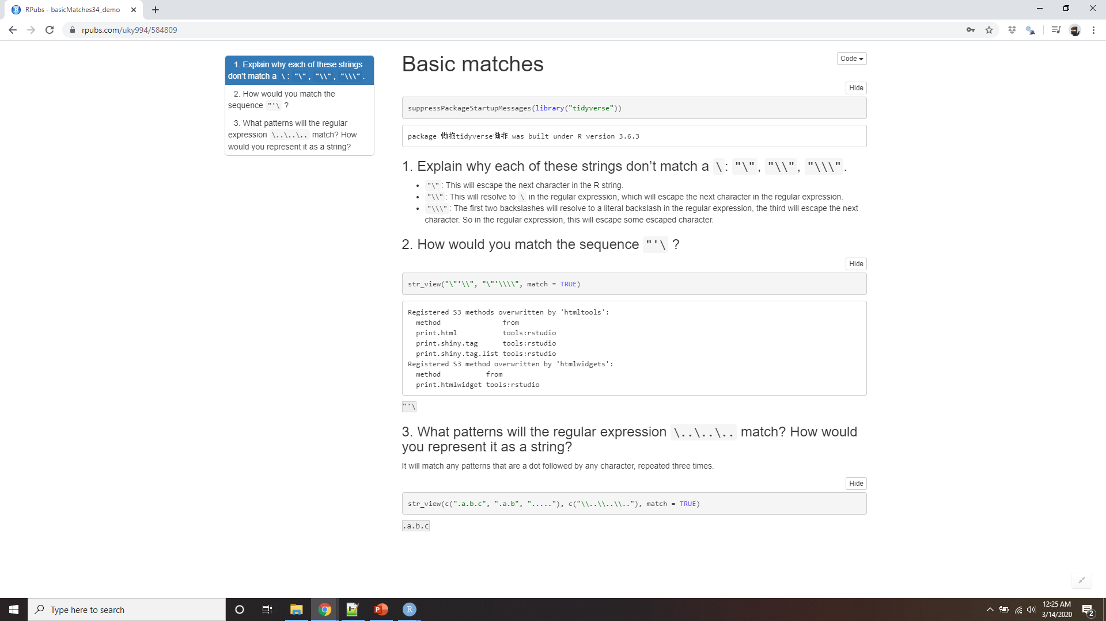
Demo basic matches
Notes:
https://rpubs.com/uky994/584806
Explain why each of these strings don’t match a \: "\", "\\", "\\\".
How would you match the sequence "'\?
What patterns will the regular expression \..\..\.. match? How would you represent it as a string?

Slide 23
Anchors
^ to match the start of the string.
x <- c("apple", "banana", "pear")
str_view(x, "^a")
apple
banana
pear
$ to match the end of the string.
str_view(x, "a$")
apple
banana
pear
To remember which is which, try this mnemonic which I learned from Evan Misshula: if you begin with power (^), you end up with money ($).
Notes:
By default, regular expressions will match any part of a string. It’s often useful to anchor the regular expression so that it matches from the start or end of the string. You can use:
^ to match the start of the string.
$ to match the end of the string.
To remember which is which, try this mnemonic which I learned from Evan Misshula: if you begin with power (^), you end up with money ($).

Slide 24
Anchors
x <- c("apple pie", "apple", "apple cake")
str_view(x, "apple")
apple pie
apple
apple cake
str_view(x, "^apple$")
apple pie
apple
apple cake
Notes:
To force a regular expression to only match a complete string, anchor it with both ^ and $:
You can also match the boundary between words with \b. I don’t often use this in R, but I will sometimes use it when I’m doing a search in RStudio when I want to find the name of a function that’s a component of other functions. For example, I’ll search for \bsum\b to avoid matching summarise, summary, rowsum and so on.

Slide 25
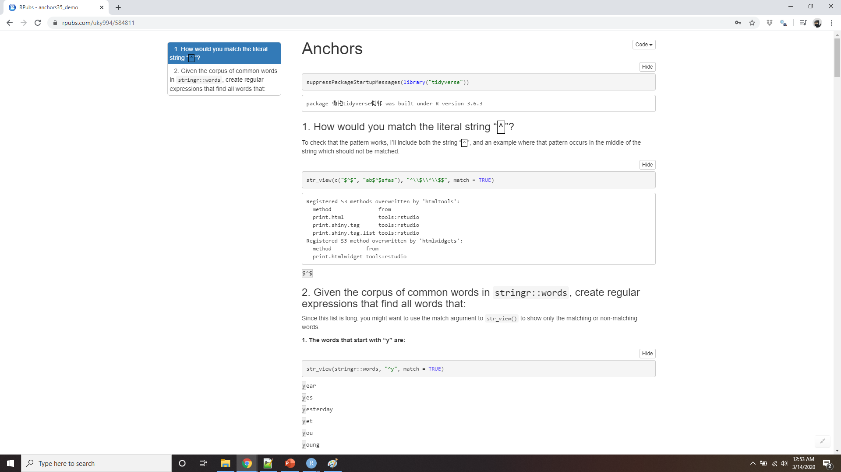
Demo anchors
Notes:
https://rpubs.com/uky994/584811
How would you match the literal string "$^$"?
Given the corpus of common words in stringr::words, create regular expressions that find all words that:
Start with “y”.
End with “x”
Are exactly three letters long. (Don’t cheat by using str_length()!)
Have seven letters or more.
Since this list is long, you might want to use the match argument to str_view() to show only the matching or non-matching words.

Slide 26
Character classes and alternatives
\d: matches any digit.
\s: matches any whitespace (e.g. space, tab, newline).
[abc]: matches a, b, or c.
[^abc]: matches anything except a, b, or c.
Notes:
There are a number of special patterns that match more than one character. You’ve already seen ., which matches any character apart from a newline. There are four other useful tools:
\d: matches any digit.
\s: matches any whitespace (e.g. space, tab, newline).
[abc]: matches a, b, or c.
[^abc]: matches anything except a, b, or c.
Remember, to create a regular expression containing \d or \s, you’ll need to escape the \ for the string, so you’ll type "\\d" or "\\s"

Slide 27
Character classes and alternatives
# Look for a literal character that normally
# has special meaning in a regex
str_view(c("abc", "a.c", "a*c", "a c"), "a[.]c")
abc
a.c
a*c
a c
abc
a.c
a*c
a c
str_view(c("abc", "a.c", "a*c", "a c"), ".[*]c")
abc
a.c
a*c
a c
str_view(c("abc", "a.c", "a*c", "a c"), "a[ ]")
Notes:
A character class containing a single character is a nice alternative to backslash escapes when you want to include a single metacharacter in a regex. Many people find this more readable.
This works for most (but not all) regex metacharacters: $ . | ? * + ( ) [ {. Unfortunately, a few characters have special meaning even inside a character class and must be handled with backslash escapes: ] \ ^ and -

Slide 28
alternation
str_view(c("grey", "gray"), "gr(e|a)y")
grey
gray
Notes:
You can use alternation to pick between one or more alternative patterns. For example, abc|d..f will match either ‘“abc”’, or "deaf". Note that the precedence for | is low, so that abc|xyz matches abc or xyz not abcyz or abxyz. Like with mathematical expressions, if precedence ever gets confusing, use parentheses to make it clear what you want:

Slide 29
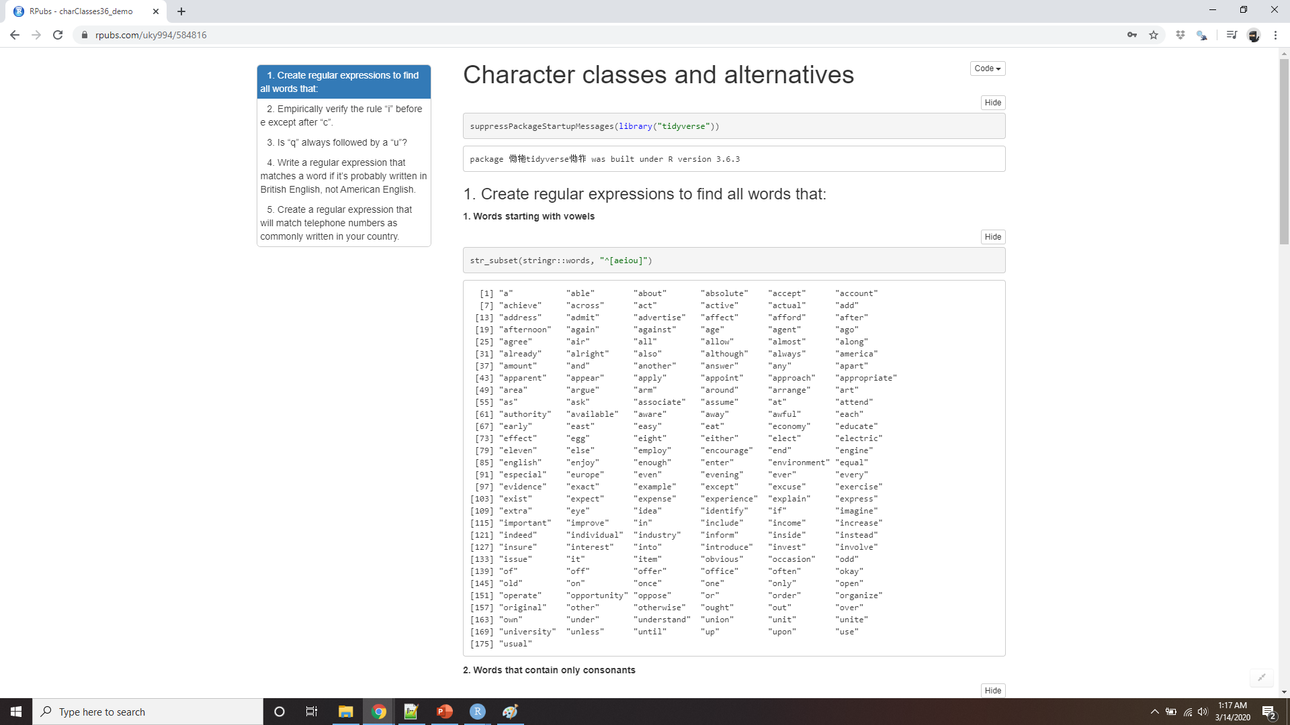
Demo Character classes and alternatives
Notes:
https://rpubs.com/uky994/584816
Create regular expressions to find all words that:
Start with a vowel.
That only contain consonants. (Hint: thinking about matching “not”-vowels.)
End with ed, but not with eed.
End with ing or ise.
Empirically verify the rule “i before e except after c”.
Is “q” always followed by a “u”?
Write a regular expression that matches a word if it’s probably written in British English, not American English.
Create a regular expression that will match telephone numbers as commonly written in your country.

Slide 30
Repetition
?: 0 or 1
+: 1 or more
*: 0 or more
Notes:
The next step up in power involves controlling how many times a pattern matches:
?: 0 or 1
+: 1 or more
*: 0 or more

Slide 31
Repetition
x <- "1888 is the longest year in Roman numerals: MDCCCLXXXVIII"
str_view(x, "CC?")
1888 is the longest year in Roman numerals: MDCCCLXXXVIII
str_view(x, "CC+")
1888 is the longest year in Roman numerals: MDCCCLXXXVIII
str_view(x, 'C[LX]+')
1888 is the longest year in Roman numerals: MDCCCLXXXVIII
Notes:
Note that the precedence of these operators is high, so you can write: colou?r to match either American or British spellings. That means most uses will need parentheses, like bana(na)+.

Slide 32
Repetition
You can also specify the number of matches precisely:
{n}: exactly n
{n,}: n or more
{,m}: at most m
{n,m}: between n and m
Notes:
You can also specify the number of matches precisely:
{n}: exactly n
{n,}: n or more
{,m}: at most m
{n,m}: between n and m

Slide 33
Repetition
str_view(x, "C{2}")
1888 is the longest year in Roman numerals: MDCCCLXXXVIII
str_view(x, "C{2,}")
1888 is the longest year in Roman numerals: MDCCCLXXXVIII
str_view(x, "C{2,3}")
1888 is the longest year in Roman numerals: MDCCCLXXXVIII
Notes:
By default these matches are “greedy”: they will match the longest string possible.

Slide 34
Repetition
str_view(x, 'C{2,3}?')
1888 is the longest year in Roman numerals: MDCCCLXXXVIII
str_view(x, 'C[LX]+?')
1888 is the longest year in Roman numerals: MDCCCLXXXVIII
Notes:
You can make them “lazy”, matching the shortest string possible by putting a ? after them. This is an advanced feature of regular expressions, but it’s useful to know that it exists:

Slide 35
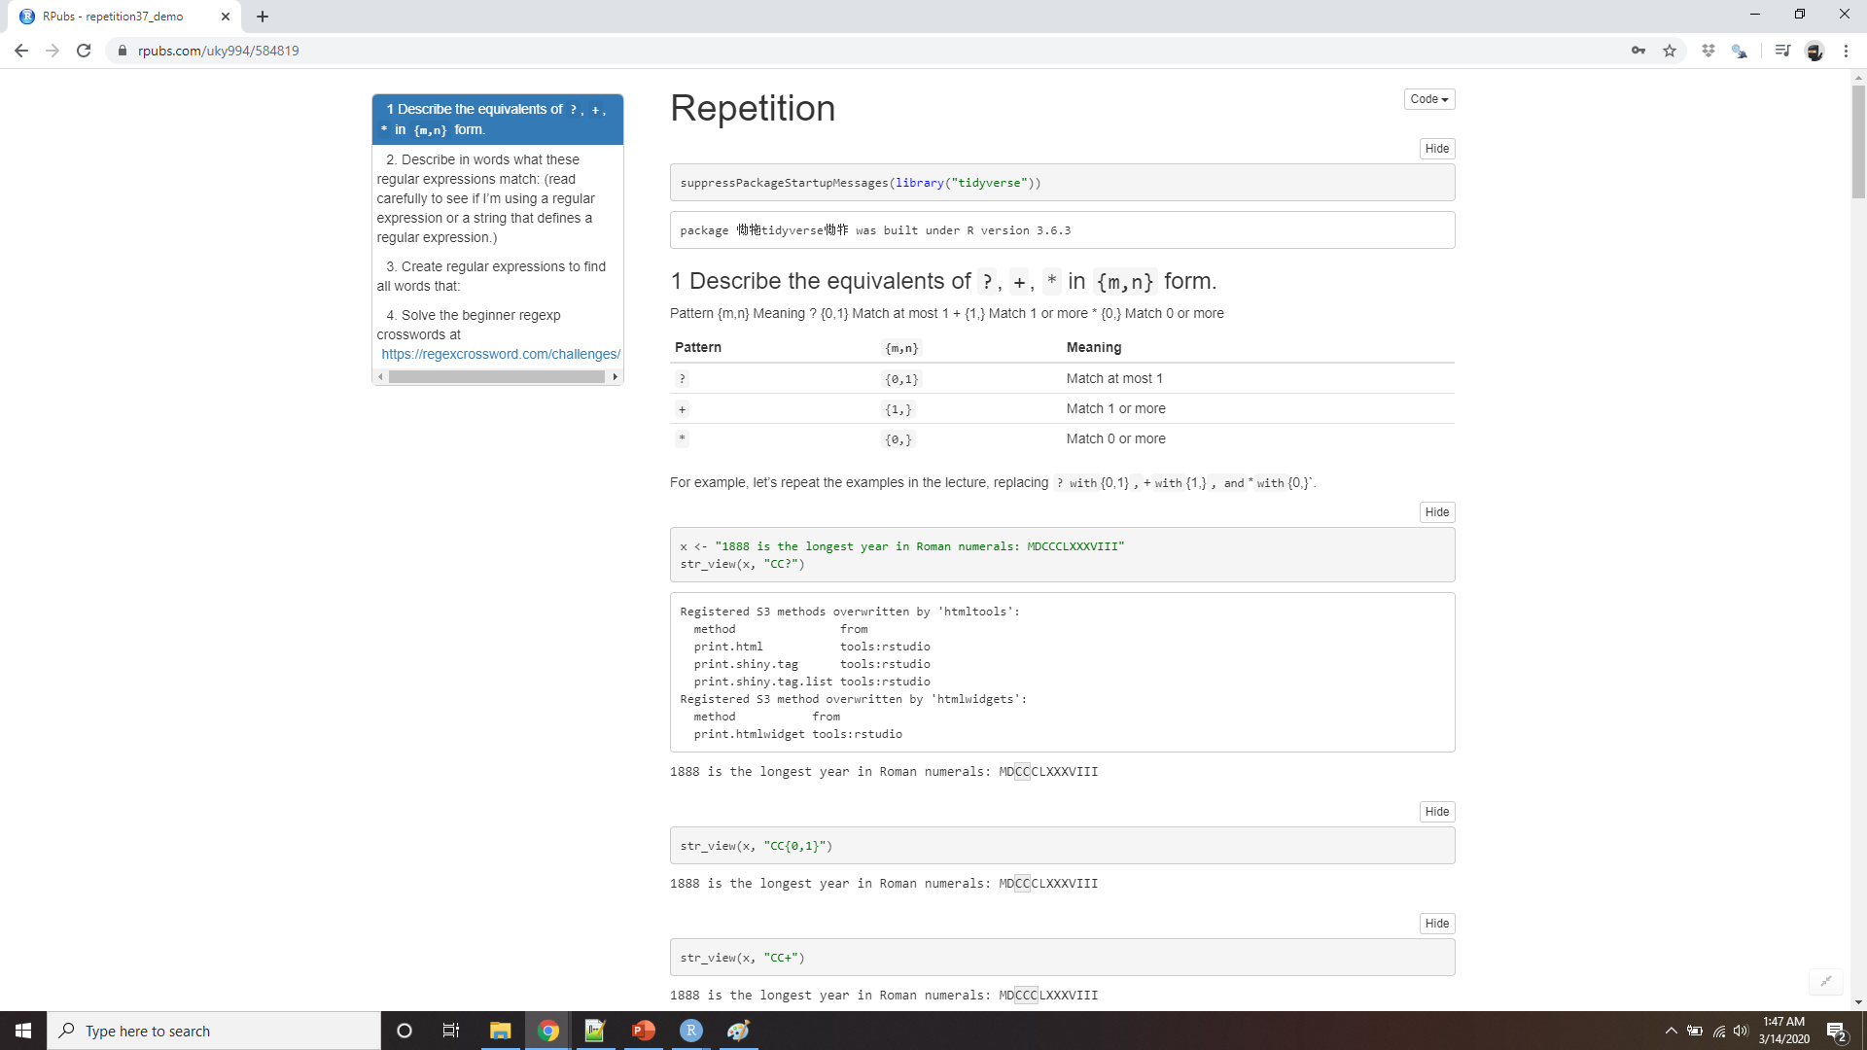
Demo repetition
Notes:
https://rpubs.com/uky994/584819
Describe the equivalents of ?, +, * in {m,n} form.
Describe in words what these regular expressions match: (read carefully to see if I’m using a regular expression or a string that defines a regular expression.)
^.*$
"\\{.+\\}"
\d{4}-\d{2}-\d{2}
"\\\\{4}"
Create regular expressions to find all words that:
Start with three consonants.
Have three or more vowels in a row.
Have two or more vowel-consonant pairs in a row.
Solve the beginner regexp crosswords at https://regexcrossword.com/challenges/beginner.

Slide 36
Grouping and backreferences
str_view(fruit, "(..)\\1", match = TRUE)
banana
coconut
cucumber
jujube
papaya
salal berry
Notes:
Earlier, you learned about parentheses as a way to disambiguate complex expressions. Parentheses also create a numbered capturing group (number 1, 2 etc.). A capturing group stores the part of the string matched by the part of the regular expression inside the parentheses. You can refer to the same text as previously matched by a capturing group with backreferences, like \1, \2 etc. For example, the following regular expression finds all fruits that have a repeated pair of letters.
(Shortly, you’ll also see how they’re useful in conjunction with str_match().)

Slide 37
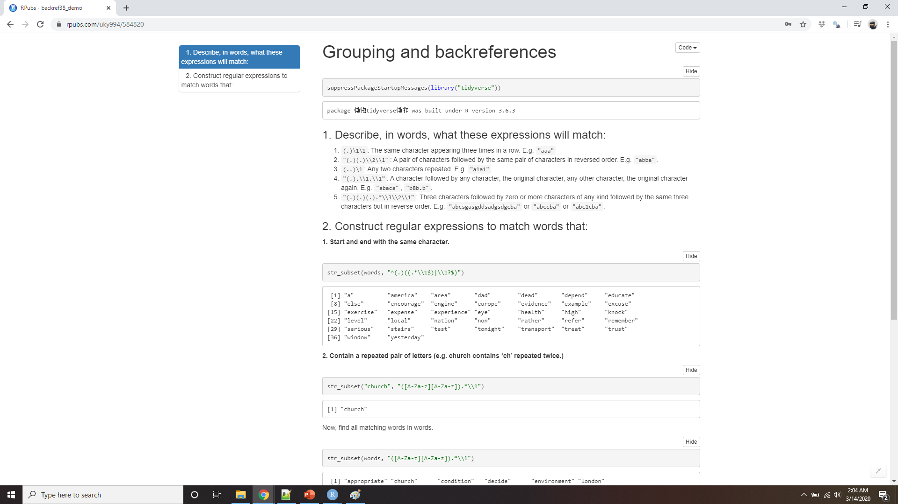
Demo Grouping and backreferences
Notes:
https://rpubs.com/uky994/584820
Describe, in words, what these expressions will match:
(.)\1\1
"(.)(.)\\2\\1"
(..)\1
"(.).\\1.\\1"
"(.)(.)(.).*\\3\\2\\1"
Construct regular expressions to match words that:
Start and end with the same character.
Contain a repeated pair of letters (e.g. “church” contains “ch” repeated twice.)
Contain one letter repeated in at least three places (e.g. “eleven” contains three “e”s.)

Slide 38

Tools
Determine which strings match a pattern.
Find the positions of matches.
Extract the content of matches.
Replace matches with new values.
Split a string based on a match.
Some people, when confronted with a problem, think “I know, I’ll use regular expressions.” Now they have two problems.
-Jamie Zawinski
Notes:
Now that you’ve learned the basics of regular expressions, it’s time to learn how to apply them to real problems. In this section you’ll learn a wide array of stringr functions that let you:
A word of caution before we continue: because regular expressions are so powerful, it’s easy to try and solve every problem with a single regular expression. In the words of Jamie Zawinski:
Some people, when confronted with a problem, think “I know, I’ll use regular expressions.” Now they have two problems.

Slide 39
(?:(?:\r\n)?[ \t])*(?:(?:(?:[^()<>@,;:\\".\[\] \000-\031]+(?:(?:(?:\r\n)?[ \t]
)+|\Z|(?=[\["()<>@,;:\\".\[\]]))|"(?:[^\"\r\\]|\\.|(?:(?:\r\n)?[ \t]))*"(?:(?:
\r\n)?[ \t])*)(?:\.(?:(?:\r\n)?[ \t])*(?:[^()<>@,;:\\".\[\] \000-\031]+(?:(?:(
?:\r\n)?[ \t])+|\Z|(?=[\["()<>@,;:\\".\[\]]))|"(?:[^\"\r\\]|\\.|(?:(?:\r\n)?[
\t]))*"(?:(?:\r\n)?[ \t])*))*@(?:(?:\r\n)?[ \t])*(?:[^()<>@,;:\\".\[\] \000-\0
31]+(?:(?:(?:\r\n)?[ \t])+|\Z|(?=[\["()<>@,;:\\".\[\]]))|\[([^\[\]\r\\]|\\.)*\
](?:(?:\r\n)?[ \t])*)(?:\.(?:(?:\r\n)?[ \t])*(?:[^()<>@,;:\\".\[\] \000-\031]+
(?:(?:(?:\r\n)?[ \t])+|\Z|(?=[\["()<>@,;:\\".\[\]]))|\[([^\[\]\r\\]|\\.)*\](?:
(?:\r\n)?[ \t])*))*|(?:[^()<>@,;:\\".\[\] \000-\031]+(?:(?:(?:\r\n)?[ \t])+|\Z
|(?=[\["()<>@,;:\\".\[\]]))|"(?:[^\"\r\\]|\\.|(?:(?:\r\n)?[ \t]))*"(?:(?:\r\n)
?[ \t])*)*\<(?:(?:\r\n)?[ \t])*(?:@(?:[^()<>@,;:\\".\[\] \000-\031]+(?:(?:(?:\
r\n)?[ \t])+|\Z|(?=[\["()<>@,;:\\".\[\]]))|\[([^\[\]\r\\]|\\.)*\](?:(?:\r\n)?[
\t])*)(?:\.(?:(?:\r\n)?[ \t])*(?:[^()<>@,;:\\".\[\] \000-\031]+(?:(?:(?:\r\n)
?[ \t])+|\Z|(?=[\["()<>@,;:\\".\[\]]))|\[([^\[\]\r\\]|\\.)*\](?:(?:\r\n)?[ \t]
)*))*(?:,@(?:(?:\r\n)?[ \t])*(?:[^()<>@,;:\\".\[\] \000-\031]+(?:(?:(?:\r\n)?[
\t])+|\Z|(?=[\["()<>@,;:\\".\[\]]))|\[([^\[\]\r\\]|\\.)*\](?:(?:\r\n)?[ \t])*
)(?:\.(?:(?:\r\n)?[ \t])*(?:[^()<>@,;:\\".\[\] \000-\031]+(?:(?:(?:\r\n)?[ \t]
)+|\Z|(?=[\["()<>@,;:\\".\[\]]))|\[([^\[\]\r\\]|\\.)*\](?:(?:\r\n)?[ \t])*))*)
*:(?:(?:\r\n)?[ \t])*)?(?:[^()<>@,;:\\".\[\] \000-\031]+(?:(?:(?:\r\n)?[ \t])+
|\Z|(?=[\["()<>@,;:\\".\[\]]))|"(?:[^\"\r\\]|\\.|(?:(?:\r\n)?[ \t]))*"(?:(?:\r
\n)?[ \t])*)(?:\.(?:(?:\r\n)?[ \t])*(?:[^()<>@,;:\\".\[\] \000-\031]+(?:(?:(?:
\r\n)?[ \t])+|\Z|(?=[\["()<>@,;:\\".\[\]]))|"(?:[^\"\r\\]|\\.|(?:(?:\r\n)?[ \t
]))*"(?:(?:\r\n)?[ \t])*))*@(?:(?:\r\n)?[ \t])*(?:[^()<>@,;:\\".\[\] \000-\031
]+(?:(?:(?:\r\n)?[ \t])+|\Z|(?=[\["()<>@,;:\\".\[\]]))|\[([^\[\]\r\\]|\\.)*\](
?:(?:\r\n)?[ \t])*)(?:\.(?:(?:\r\n)?[ \t])*(?:[^()<>@,;:\\".\[\] \000-\031]+(?
:(?:(?:\r\n)?[ \t])+|\Z|(?=[\["()<>@,;:\\".\[\]]))|\[([^\[\]\r\\]|\\.)*\](?:(?
:\r\n)?[ \t])*))*\>(?:(?:\r\n)?[ \t])*)|(?:[^()<>@,;:\\".\[\] \000-\031]+(?:(?
:(?:\r\n)?[ \t])+|\Z|(?=[\["()<>@,;:\\".\[\]]))|"(?:[^\"\r\\]|\\.|(?:(?:\r\n)?
[ \t]))*"(?:(?:\r\n)?[ \t])*)*:(?:(?:\r\n)?[ \t])*(?:(?:(?:[^()<>@,;:\\".\[\]
\000-\031]+(?:(?:(?:\r\n)?[ \t])+|\Z|(?=[\["()<>@,;:\\".\[\]]))|"(?:[^\"\r\\]|
\\.|(?:(?:\r\n)?[ \t]))*"(?:(?:\r\n)?[ \t])*)(?:\.(?:(?:\r\n)?[ \t])*(?:[^()<>
@,;:\\".\[\] \000-\031]+(?:(?:(?:\r\n)?[ \t])+|\Z|(?=[\["()<>@,;:\\".\[\]]))|"
(?:[^\"\r\\]|\\.|(?:(?:\r\n)?[ \t]))*"(?:(?:\r\n)?[ \t])*))*@(?:(?:\r\n)?[ \t]
)*(?:[^()<>@,;:\\".\[\] \000-\031]+(?:(?:(?:\r\n)?[ \t])+|\Z|(?=[\["()<>@,;:\\
".\[\]]))|\[([^\[\]\r\\]|\\.)*\](?:(?:\r\n)?[ \t])*)(?:\.(?:(?:\r\n)?[ \t])*(?
:[^()<>@,;:\\".\[\] \000-\031]+(?:(?:(?:\r\n)?[ \t])+|\Z|(?=[\["()<>@,;:\\".\[
\]]))|\[([^\[\]\r\\]|\\.)*\](?:(?:\r\n)?[ \t])*))*|(?:[^()<>@,;:\\".\[\] \000-
\031]+(?:(?:(?:\r\n)?[ \t])+|\Z|(?=[\["()<>@,;:\\".\[\]]))|"(?:[^\"\r\\]|\\.|(
?:(?:\r\n)?[ \t]))*"(?:(?:\r\n)?[ \t])*)*\<(?:(?:\r\n)?[ \t])*(?:@(?:[^()<>@,;
:\\".\[\] \000-\031]+(?:(?:(?:\r\n)?[ \t])+|\Z|(?=[\["()<>@,;:\\".\[\]]))|\[([
^\[\]\r\\]|\\.)*\](?:(?:\r\n)?[ \t])*)(?:\.(?:(?:\r\n)?[ \t])*(?:[^()<>@,;:\\"
.\[\] \000-\031]+(?:(?:(?:\r\n)?[ \t])+|\Z|(?=[\["()<>@,;:\\".\[\]]))|\[([^\[\
]\r\\]|\\.)*\](?:(?:\r\n)?[ \t])*))*(?:,@(?:(?:\r\n)?[ \t])*(?:[^()<>@,;:\\".\
[\] \000-\031]+(?:(?:(?:\r\n)?[ \t])+|\Z|(?=[\["()<>@,;:\\".\[\]]))|\[([^\[\]\
r\\]|\\.)*\](?:(?:\r\n)?[ \t])*)(?:\.(?:(?:\r\n)?[ \t])*(?:[^()<>@,;:\\".\[\]
\000-\031]+(?:(?:(?:\r\n)?[ \t])+|\Z|(?=[\["()<>@,;:\\".\[\]]))|\[([^\[\]\r\\]
|\\.)*\](?:(?:\r\n)?[ \t])*))*)*:(?:(?:\r\n)?[ \t])*)?(?:[^()<>@,;:\\".\[\] \0
00-\031]+(?:(?:(?:\r\n)?[ \t])+|\Z|(?=[\["()<>@,;:\\".\[\]]))|"(?:[^\"\r\\]|\\
.|(?:(?:\r\n)?[ \t]))*"(?:(?:\r\n)?[ \t])*)(?:\.(?:(?:\r\n)?[ \t])*(?:[^()<>@,
;:\\".\[\] \000-\031]+(?:(?:(?:\r\n)?[ \t])+|\Z|(?=[\["()<>@,;:\\".\[\]]))|"(?
:[^\"\r\\]|\\.|(?:(?:\r\n)?[ \t]))*"(?:(?:\r\n)?[ \t])*))*@(?:(?:\r\n)?[ \t])*
(?:[^()<>@,;:\\".\[\] \000-\031]+(?:(?:(?:\r\n)?[ \t])+|\Z|(?=[\["()<>@,;:\\".
\[\]]))|\[([^\[\]\r\\]|\\.)*\](?:(?:\r\n)?[ \t])*)(?:\.(?:(?:\r\n)?[ \t])*(?:[
^()<>@,;:\\".\[\] \000-\031]+(?:(?:(?:\r\n)?[ \t])+|\Z|(?=[\["()<>@,;:\\".\[\]
]))|\[([^\[\]\r\\]|\\.)*\](?:(?:\r\n)?[ \t])*))*\>(?:(?:\r\n)?[ \t])*)(?:,\s*(
?:(?:[^()<>@,;:\\".\[\] \000-\031]+(?:(?:(?:\r\n)?[ \t])+|\Z|(?=[\["()<>@,;:\\
".\[\]]))|"(?:[^\"\r\\]|\\.|(?:(?:\r\n)?[ \t]))*"(?:(?:\r\n)?[ \t])*)(?:\.(?:(
?:\r\n)?[ \t])*(?:[^()<>@,;:\\".\[\] \000-\031]+(?:(?:(?:\r\n)?[ \t])+|\Z|(?=[
\["()<>@,;:\\".\[\]]))|"(?:[^\"\r\\]|\\.|(?:(?:\r\n)?[ \t]))*"(?:(?:\r\n)?[ \t
])*))*@(?:(?:\r\n)?[ \t])*(?:[^()<>@,;:\\".\[\] \000-\031]+(?:(?:(?:\r\n)?[ \t
])+|\Z|(?=[\["()<>@,;:\\".\[\]]))|\[([^\[\]\r\\]|\\.)*\](?:(?:\r\n)?[ \t])*)(?
:\.(?:(?:\r\n)?[ \t])*(?:[^()<>@,;:\\".\[\] \000-\031]+(?:(?:(?:\r\n)?[ \t])+|
\Z|(?=[\["()<>@,;:\\".\[\]]))|\[([^\[\]\r\\]|\\.)*\](?:(?:\r\n)?[ \t])*))*|(?:
[^()<>@,;:\\".\[\] \000-\031]+(?:(?:(?:\r\n)?[ \t])+|\Z|(?=[\["()<>@,;:\\".\[\
]]))|"(?:[^\"\r\\]|\\.|(?:(?:\r\n)?[ \t]))*"(?:(?:\r\n)?[ \t])*)*\<(?:(?:\r\n)
?[ \t])*(?:@(?:[^()<>@,;:\\".\[\] \000-\031]+(?:(?:(?:\r\n)?[ \t])+|\Z|(?=[\["
()<>@,;:\\".\[\]]))|\[([^\[\]\r\\]|\\.)*\](?:(?:\r\n)?[ \t])*)(?:\.(?:(?:\r\n)
?[ \t])*(?:[^()<>@,;:\\".\[\] \000-\031]+(?:(?:(?:\r\n)?[ \t])+|\Z|(?=[\["()<>
@,;:\\".\[\]]))|\[([^\[\]\r\\]|\\.)*\](?:(?:\r\n)?[ \t])*))*(?:,@(?:(?:\r\n)?[
\t])*(?:[^()<>@,;:\\".\[\] \000-\031]+(?:(?:(?:\r\n)?[ \t])+|\Z|(?=[\["()<>@,
;:\\".\[\]]))|\[([^\[\]\r\\]|\\.)*\](?:(?:\r\n)?[ \t])*)(?:\.(?:(?:\r\n)?[ \t]
)*(?:[^()<>@,;:\\".\[\] \000-\031]+(?:(?:(?:\r\n)?[ \t])+|\Z|(?=[\["()<>@,;:\\
".\[\]]))|\[([^\[\]\r\\]|\\.)*\](?:(?:\r\n)?[ \t])*))*)*:(?:(?:\r\n)?[ \t])*)?
(?:[^()<>@,;:\\".\[\] \000-\031]+(?:(?:(?:\r\n)?[ \t])+|\Z|(?=[\["()<>@,;:\\".
\[\]]))|"(?:[^\"\r\\]|\\.|(?:(?:\r\n)?[ \t]))*"(?:(?:\r\n)?[ \t])*)(?:\.(?:(?:
\r\n)?[ \t])*(?:[^()<>@,;:\\".\[\] \000-\031]+(?:(?:(?:\r\n)?[ \t])+|\Z|(?=[\[
"()<>@,;:\\".\[\]]))|"(?:[^\"\r\\]|\\.|(?:(?:\r\n)?[ \t]))*"(?:(?:\r\n)?[ \t])
*))*@(?:(?:\r\n)?[ \t])*(?:[^()<>@,;:\\".\[\] \000-\031]+(?:(?:(?:\r\n)?[ \t])
+|\Z|(?=[\["()<>@,;:\\".\[\]]))|\[([^\[\]\r\\]|\\.)*\](?:(?:\r\n)?[ \t])*)(?:\
.(?:(?:\r\n)?[ \t])*(?:[^()<>@,;:\\".\[\] \000-\031]+(?:(?:(?:\r\n)?[ \t])+|\Z
|(?=[\["()<>@,;:\\".\[\]]))|\[([^\[\]\r\\]|\\.)*\](?:(?:\r\n)?[ \t])*))*\>(?:(
?:\r\n)?[ \t])*))*)?;\s*)
http://stackoverflow.com/a/201378
Notes:
As a cautionary tale, check out this regular expression that checks if a email address is valid:
This is a somewhat pathological example (because email addresses are actually surprisingly complex), but is used in real code. See the stackoverflow discussion at http://stackoverflow.com/a/201378 for more details.
Don’t forget that you’re in a programming language and you have other tools at your disposal. Instead of creating one complex regular expression, it’s often easier to write a series of simpler regexps. If you get stuck trying to create a single regexp that solves your problem, take a step back and think if you could break the problem down into smaller pieces, solving each challenge before moving onto the next one.

Slide 40
Detect matches
To determine if a character vector matches a pattern, use str_detect().
It returns a logical vector the same length as the input
x <- c("apple", "banana", "pear")
str_detect(x, "e")
#> [1] TRUE FALSE TRUE
Notes:
To determine if a character vector matches a pattern, use str_detect(). It returns a logical vector the same length as the input:

Slide 41
use a logical vector in a numeric context
# How many common words start with t?
sum(str_detect(words, "^t"))
#> [1] 65
# What proportion of common words end with a vowel?
mean(str_detect(words, "[aeiou]$"))
#> [1] 0.277
Notes:
Remember that when you use a logical vector in a numeric context, FALSE becomes 0 and TRUE becomes 1. That makes sum() and mean() useful if you want to answer questions about matches across a larger vector:

Slide 42
combine multiple str_detect()
# Find all words containing at least one vowel, and negate
no_vowels_1 <- !str_detect(words, "[aeiou]")
# Find all words consisting only of consonants (non-vowels)
no_vowels_2 <- str_detect(words, "^[^aeiou]+$")
identical(no_vowels_1, no_vowels_2)
#> [1] TRUE
Notes:
When you have complex logical conditions (e.g. match a or b but not c unless d) it’s often easier to combine multiple str_detect() calls with logical operators, rather than trying to create a single regular expression. For example, here are two ways to find all words that don’t contain any vowels:
The results are identical, but I think the first approach is significantly easier to understand. If your regular expression gets overly complicated, try breaking it up into smaller pieces, giving each piece a name, and then combining the pieces with logical operations.

Slide 43
str_subset()
words[str_detect(words, "x$")]
#> [1] "box" "sex" "six" "tax“
str_subset(words, "x$")
#> [1] "box" "sex" "six" "tax"
Notes:
A common use of str_detect() is to select the elements that match a pattern. You can do this with logical subsetting, or the convenient str_subset() wrapper

Slide 44
Using filter
df <- tibble(
word = words,
i = seq_along(word)
)
df %>%
filter(str_detect(word, "x$"))
#> # A tibble: 4 x 2
#> word i
#> <chr> <int>
#> 1 box 108
#> 2 sex 747
#> 3 six 772
#> 4 tax 841
Notes:
Typically, however, your strings will be one column of a data frame, and you’ll want to use filter instead:

Slide 45
Str_count()
x <- c("apple", "banana", "pear")
str_count(x, "a")
#> [1] 1 3 1
# On average, how many vowels per word?
mean(str_count(words, "[aeiou]"))
#> [1] 1.99
Notes:
A variation on str_detect() is str_count(): rather than a simple yes or no, it tells you how many matches there are in a string:

Slide 46
str_count() with mutate():
df %>%
mutate(
vowels = str_count(word, "[aeiou]"),
consonants = str_count(word, "[^aeiou]")
)
#> # A tibble: 980 x 4
#> word i vowels consonants
#> <chr> <int> <int> <int>
#> 1 a 1 1 0
#> 2 able 2 2 2
#> 3 about 3 3 2
#> 4 absolute 4 4 4
#> 5 accept 5 2 4
#> 6 account 6 3 4
#> # … with 974 more rows
Notes:
It’s natural to use str_count() with mutate():

Slide 47

stringr functions come in pairs
Note that matches never overlap.
str_count("abababa", "aba")
#> [1] 2
str_view_all("abababa", "aba")
abababa
_all
Notes:
Note that matches never overlap. For example, in "abababa", how many times will the pattern "aba" match? Regular expressions say two, not three:
Note the use of str_view_all(). As you’ll shortly learn, many stringr functions come in pairs: one function works with a single match, and the other works with all matches. The second function will have the suffix _all.

Slide 48
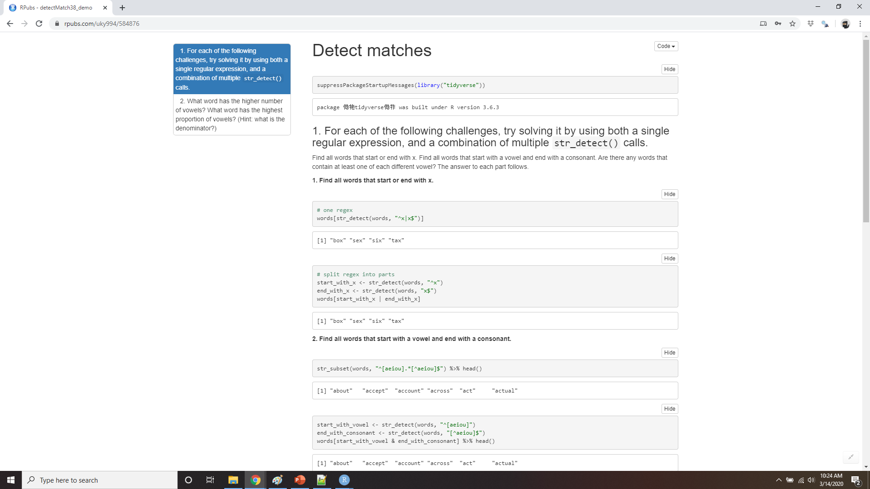
Demo detect matches
Notes:
https://rpubs.com/uky994/584876
For each of the following challenges, try solving it by using both a single regular expression, and a combination of multiple str_detect() calls.
Find all words that start or end with x.
Find all words that start with a vowel and end with a consonant.
Are there any words that contain at least one of each different vowel?
What word has the highest number of vowels? What word has the highest proportion of vowels? (Hint: what is the denominator?)

Slide 49
Extract matches
https://en.wikipedia.org/wiki/Harvard_sentences
length(sentences)
#> [1] 720
head(sentences)
#> [1] "The birch canoe slid on the smooth planks."
#> [2] "Glue the sheet to the dark blue background."
#> [3] "It's easy to tell the depth of a well."
#> [4] "These days a chicken leg is a rare dish."
#> [5] "Rice is often served in round bowls."
#> [6] "The juice of lemons makes fine punch."
Notes:
To extract the actual text of a match, use str_extract(). To show that off, we’re going to need a more complicated example. I’m going to use the Harvard sentences, which were designed to test VOIP systems, but are also useful for practicing regexps. These are provided in stringr::sentences:

Slide 50
Extract matches
colours <- c("red", "orange", "yellow", "green", "blue", "purple")
colour_match <- str_c(colours, collapse = "|")
colour_match
#> [1] "red|orange|yellow|green|blue|purple"
Notes:
Imagine we want to find all sentences that contain a colour. We first create a vector of colour names, and then turn it into a single regular expression:

Slide 51
Extract matches
has_colour <- str_subset(sentences, colour_match)
matches <- str_extract(has_colour, colour_match)
head(matches)
#> [1] "blue" "blue" "red" "red" "red" "blue"
Notes:
Now we can select the sentences that contain a colour, and then extract the colour to figure out which one it is:

Slide 52
Str_extract()
more <- sentences[str_count(sentences, colour_match) > 1]
str_view_all(more, colour_match)
It is hard to erase blue or red ink.
The green light in the brown box flickered.
The sky in the west is tinged with orange red.
str_extract(more, colour_match)
#> [1] "blue" "green" "orange"
Notes:
Note that str_extract() only extracts the first match. We can see that most easily by first selecting all the sentences that have more than 1 match:

Slide 53
str_extract_all()
str_extract_all(more, colour_match)
#> [[1]]
#> [1] "blue" "red"
#>
#> [[2]]
#> [1] "green" "red"
#>
#> [[3]]
#> [1] "orange" "red"
Notes:
This is a common pattern for stringr functions, because working with a single match allows you to use much simpler data structures. To get all matches, use str_extract_all(). It returns a list:
You’ll learn more about lists in lists and iteration.

Slide 54
simplify = TRUE
str_extract_all(more, colour_match, simplify = TRUE)
#> [,1] [,2]
#> [1,] "blue" "red"
#> [2,] "green" "red"
#> [3,] "orange" "red"
x <- c("a", "a b", "a b c")
str_extract_all(x, "[a-z]", simplify = TRUE)
#> [,1] [,2] [,3]
#> [1,] "a" "" ""
#> [2,] "a" "b" ""
#> [3,] "a" "b" "c"
Notes:
If you use simplify = TRUE, str_extract_all() will return a matrix with short matches expanded to the same length as the longest:

Slide 55
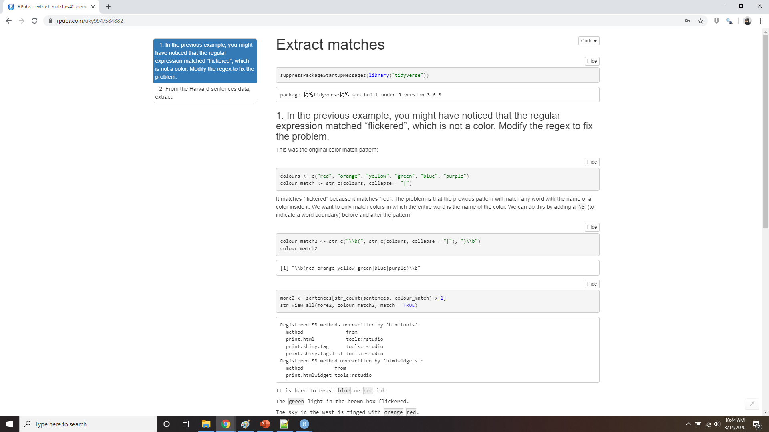
Demo extract matches
Notes:
https://rpubs.com/uky994/584882
In the previous example, you might have noticed that the regular expression matched “flickered”, which is not a colour. Modify the regex to fix the problem.
From the Harvard sentences data, extract:
The first word from each sentence.
All words ending in ing.
All plurals.

Slide 56
Grouped matches
noun <- "(a|the) ([^ ]+)"
has_noun <- sentences %>%
str_subset(noun) %>%
head(10)
has_noun %>%
str_extract(noun)
#> [1] "the smooth" "the sheet" "the depth" "a chicken" "the parked"
#> [6] "the sun" "the huge" "the ball" "the woman" "a helps"
Notes:
Earlier in this chapter we talked about the use of parentheses for clarifying precedence and for backreferences when matching. You can also use parentheses to extract parts of a complex match. For example, imagine we want to extract nouns from the sentences. As a heuristic, we’ll look for any word that comes after “a” or “the”. Defining a “word” in a regular expression is a little tricky, so here I use a simple approximation: a sequence of at least one character that isn’t a space.

Slide 57
str_match()
has_noun %>%
str_match(noun)
#> [,1] [,2] [,3]
#> [1,] "the smooth" "the" "smooth"
#> [2,] "the sheet" "the" "sheet"
#> [3,] "the depth" "the" "depth"
#> [4,] "a chicken" "a" "chicken"
#> [5,] "the parked" "the" "parked"
#> [6,] "the sun" "the" "sun"
#> [7,] "the huge" "the" "huge"
#> [8,] "the ball" "the" "ball"
#> [9,] "the woman" "the" "woman"
#> [10,] "a helps" "a" "helps"
Notes:
str_extract() gives us the complete match; str_match() gives each individual component. Instead of a character vector, it returns a matrix, with one column for the complete match followed by one column for each group:
(Unsurprisingly, our heuristic for detecting nouns is poor, and also picks up adjectives like smooth and parked.)

Slide 58
tidyr::extract()
tibble(sentence = sentences) %>%
tidyr::extract(
sentence, c("article", "noun"), "(a|the) ([^ ]+)",
remove = FALSE )
#> # A tibble: 720 x 3
#> sentence article noun
#> <chr> <chr> <chr>
#> 1 The birch canoe slid on the smooth planks. the smooth
#> 2 Glue the sheet to the dark blue background. the sheet
#> 3 It's easy to tell the depth of a well. the depth
#> 4 These days a chicken leg is a rare dish. a chicken
#> 5 Rice is often served in round bowls. <NA> <NA>
#> 6 The juice of lemons makes fine punch. <NA> <NA>
#> # … with 714 more rows
Notes:
If your data is in a tibble, it’s often easier to use tidyr::extract(). It works like str_match() but requires you to name the matches, which are then placed in new columns:
Like str_extract(), if you want all matches for each string, you’ll need str_match_all().

Slide 59
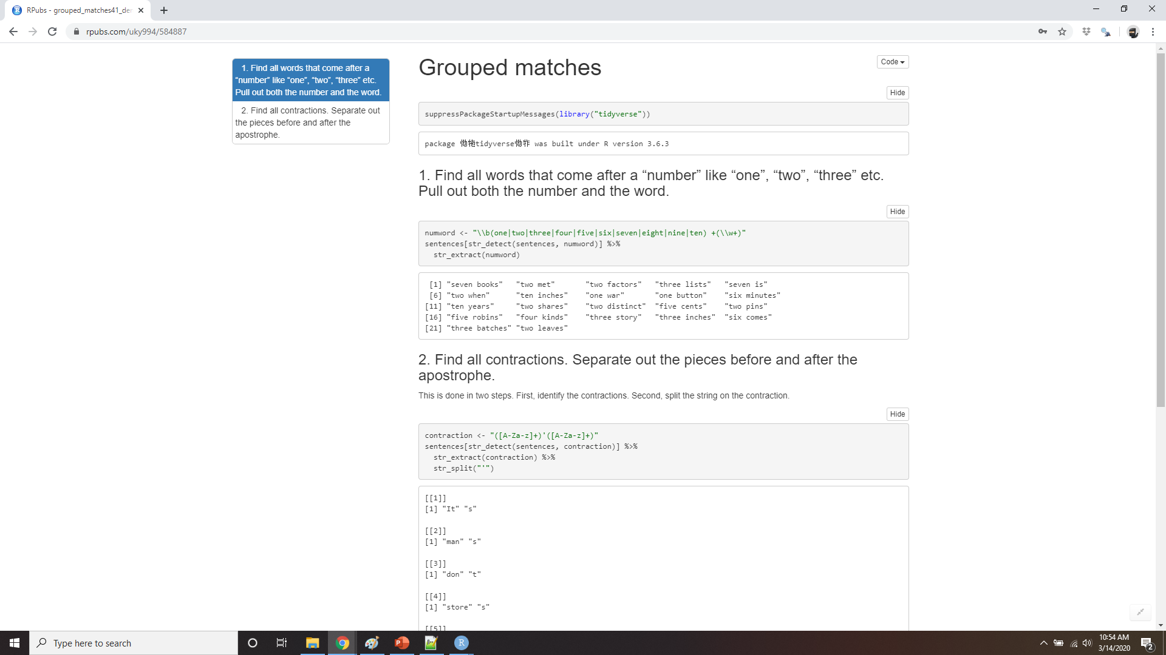
Demo grouped matches
Notes:
https://rpubs.com/uky994/584887
Find all words that come after a “number” like “one”, “two”, “three” etc. Pull out both the number and the word.
Find all contractions. Separate out the pieces before and after the apostrophe.

Slide 60
Replacing matches
str_replace() and str_replace_all() allow you to replace matches with new strings
x <- c("apple", "pear", "banana")
str_replace(x, "[aeiou]", "-")
#> [1] "-pple" "p-ar" "b-nana"
str_replace_all(x, "[aeiou]", "-")
#> [1] "-ppl-" "p--r" "b-n-n-"
Notes:
str_replace() and str_replace_all() allow you to replace matches with new strings. The simplest use is to replace a pattern with a fixed string:

Slide 61
str_replace_all()
x <- c("1 house", "2 cars", "3 people")
str_replace_all(x, c("1" = "one", "2" = "two", "3" = "three"))
#> [1] "one house" "two cars" "three people"
Notes:
With str_replace_all() you can perform multiple replacements by supplying a named vector:

Slide 62
backreferences to insert components
sentences %>%
str_replace("([^ ]+) ([^ ]+) ([^ ]+)", "\\1 \\3 \\2") %>%
head(5)
#> [1] "The canoe birch slid on the smooth planks."
#> [2] "Glue sheet the to the dark blue background."
#> [3] "It's to easy tell the depth of a well."
#> [4] "These a days chicken leg is a rare dish."
#> [5] "Rice often is served in round bowls."
Notes:
Instead of replacing with a fixed string you can use backreferences to insert components of the match. In the following code, I flip the order of the second and third words.

Slide 63
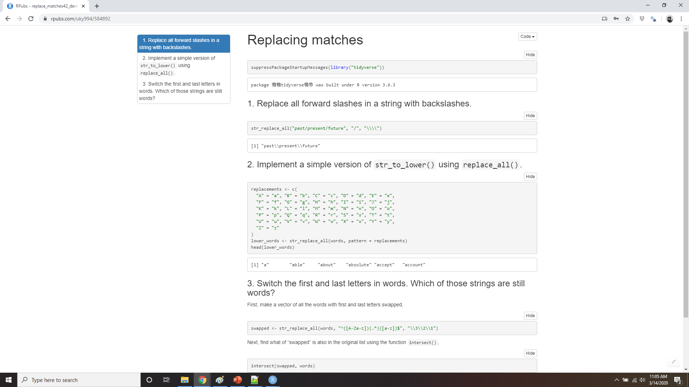
Demo replacing matches
Notes:
https://rpubs.com/uky994/584892
Replace all forward slashes in a string with backslashes.
Implement a simple version of str_to_lower() using replace_all().
Switch the first and last letters in words. Which of those strings are still words?

Slide 64
Splitting
Use str_split() to split a string up into pieces
sentences %>%
head(2) %>%
str_split(" ")
#> [[1]]
#> [1] "The" "birch" "canoe" "slid" "on" "the" "smooth"
#> [8] "planks."
#>
#> [[2]]
#> [1] "Glue" "the" "sheet" "to" "the"
#> [6] "dark" "blue" "background."
Notes:
Use str_split() to split a string up into pieces. For example, we could split sentences into words:

Slide 65
Splitting returns a list
"a|b|c|d" %>%
str_split("\\|") %>%
.[[1]]
#> [1] "a" "b" "c" "d"
extract the first element
of the list
Notes:
Because each component might contain a different number of pieces, this returns a list. If you’re working with a length-1 vector, the easiest thing is to just extract the first element of the list:

Slide 66
simplify = TRUE
sentences %>%
head(5) %>%
str_split(" ", simplify = TRUE)
#> [,1] [,2] [,3] [,4] [,5] [,6] [,7] [,8]
#> [1,] "The" "birch" "canoe" "slid" "on" "the" "smooth" "planks."
#> [2,] "Glue" "the" "sheet" "to" "the" "dark" "blue" "background."
#> [3,] "It's" "easy" "to" "tell" "the" "depth" "of" "a"
#> [4,] "These" "days" "a" "chicken" "leg" "is" "a" "rare"
#> [5,] "Rice" "is" "often" "served" "in" "round" "bowls." ""
#> [,9]
#> [1,] ""
#> [2,] ""
#> [3,] "well."
#> [4,] "dish."
#> [5,] ""
Notes:
Otherwise, like the other stringr functions that return a list, you can use simplify = TRUE to return a matrix:

Slide 67
N =
You can also request a maximum number of pieces:
fields <- c("Name: Joey", "Country: USA", "Age: 38")
fields %>% str_split(": ", n = 2, simplify = TRUE)
#> [,1] [,2]
#> [1,] "Name" “Joey"
#> [2,] "Country" “USA"
#> [3,] "Age" "38"
Notes:
You can also request a maximum number of pieces:

Slide 68
Boundary()
x <- "This is a sentence. This is another sentence."
str_view_all(x, boundary("word"))
This is a sentence. This is another sentence.
str_split(x, " ")[[1]]
#> [1] "This" "is" "a" "sentence." "" "This"
#> [7] "is" "another" "sentence."
str_split(x, boundary("word"))[[1]]
#> [1] "This" "is" "a" "sentence" "This" "is" "another"
#> [8] "sentence"
Notes:
Instead of splitting up strings by patterns, you can also split up by character, line, sentence and word boundary()s:

Slide 69
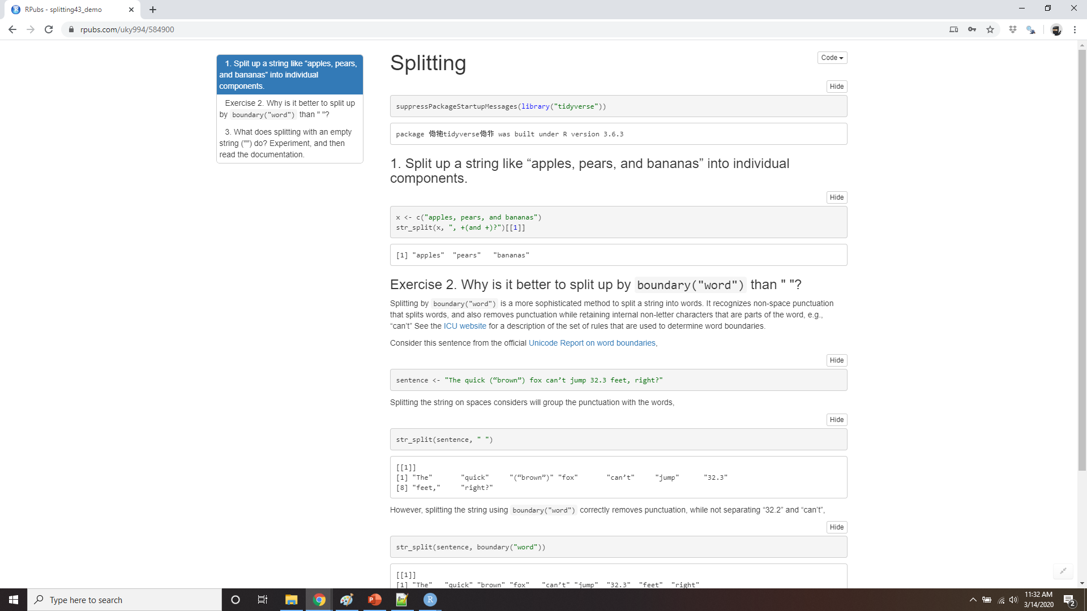
Demo Splitting
Notes:
https://rpubs.com/uky994/584900
Split up a string like "apples, pears, and bananas" into individual components.
Why is it better to split up by boundary("word") than " "?
What does splitting with an empty string ("") do? Experiment, and then read the documentation.

Slide 70
Find matches
str_locate() and str_locate_all() give you the starting and ending positions of each match
use str_locate() to find the matching pattern, str_sub() to extract and/or modify them.
Notes:
str_locate() and str_locate_all() give you the starting and ending positions of each match. These are particularly useful when none of the other functions does exactly what you want. You can use str_locate() to find the matching pattern, str_sub() to extract and/or modify them.

Slide 71
Other types of pattern
# The regular call:
str_view(fruit, "nana")
# Is shorthand for
str_view(fruit, regex("nana"))
You can use the other arguments of regex() to control details of the match
Notes:
When you use a pattern that’s a string, it’s automatically wrapped into a call to regex():
You can use the other arguments of regex() to control details of the match:

Slide 72
Ignore_case
ignore_case = TRUE allows characters to match either their uppercase or lowercase forms
bananas <- c("banana", "Banana", "BANANA")
str_view(bananas, "banana")
banana
Banana
BANANA
str_view(bananas, regex("banana", ignore_case = TRUE))
banana
Banana
BANANA
Notes:
ignore_case = TRUE allows characters to match either their uppercase or lowercase forms. This always uses the current locale.
bananas <- c("banana", "Banana", "BANANA") str_view(bananas, "banana")
banana
Banana
BANANA
str_view(bananas, regex("banana", ignore_case = TRUE))
banana
Banana
BANANA

Slide 73
multiline = TRUE
multiline = TRUE allows ^ and $ to match the start and end of each line rather than the start and end of the complete string.
x <- "Line 1\nLine 2\nLine 3"
str_extract_all(x, "^Line")[[1]]
#> [1] "Line"
str_extract_all(x, regex("^Line", multiline = TRUE))[[1]]
#> [1] "Line" "Line" "Line"
Notes:
multiline = TRUE allows ^ and $ to match the start and end of each line rather than the start and end of the complete string.

Slide 74
comments = TRUE
comments = TRUE allows you to use comments and white space to make complex regular expressions more understandable
phone <- regex("
\\(? # optional opening parens
(\\d{3}) # area code
[) -]? # optional closing parens, space, or dash
(\\d{3}) # another three numbers
[ -]? # optional space or dash
(\\d{3}) # three more numbers
", comments = TRUE)
str_match("514-791-8141", phone)
#> [,1] [,2] [,3] [,4]
#> [1,] "514-791-814" "514" "791" "814"
Notes:
comments = TRUE allows you to use comments and white space to make complex regular expressions more understandable. Spaces are ignored, as is everything after #. To match a literal space, you’ll need to escape it: "\\ ".

Slide 75
Dotall = TRUE
dotall = TRUE allows . to match everything, including \n.
Notes:
dotall = TRUE allows . to match everything, including \n.
There are three other functions you can use instead of regex():

Slide 76
Fixed()
fixed(): matches exactly the specified sequence of bytes
microbenchmark::microbenchmark(
fixed = str_detect(sentences, fixed("the")),
regex = str_detect(sentences, "the"),
times = 20
)
#> Unit: microseconds
#> expr min lq mean median uq max neval
#> fixed 54.9 63.4 124 102 118 593 20
#> regex 256.8 262.7 294 273 303 487 20
Notes:
fixed(): matches exactly the specified sequence of bytes. It ignores all special regular expressions and operates at a very low level. This allows you to avoid complex escaping and can be much faster than regular expressions. The following microbenchmark shows that it’s about 3x faster for a simple example

Slide 77
Fixed() and non-English characters
a1 <- "\u00e1"
a2 <- "a\u0301"
c(a1, a2)
#> [1] "á" "á"
a1 == a2
#> [1] FALSE
Notes:
Beware using fixed() with non-English data. It is problematic because there are often multiple ways of representing the same character. For example, there are two ways to define “á”: either as a single character or as an “a” plus an accent:
They render identically, but because they’re defined differently, fixed() doesn’t find a match. Instead, you can use coll(), defined next, to respect human character comparison rules:

Slide 78
Coll()
str_detect(a1, fixed(a2))
#> [1] FALSE
str_detect(a1, coll(a2))
#> [1] TRUE
Notes:
Instead, you can use coll(), defined next, to respect human character comparison rules:

Slide 79
Coll()
coll(): compare strings using standard collation rules.
# That means you also need to be aware of the difference
# when doing case insensitive matches:
i <- c("I", "İ", "i", "ı")
i
#> [1] "I" "İ" "i" "ı"
str_subset(i, coll("i", ignore_case = TRUE))
#> [1] "I" "i"
str_subset(i, coll("i", ignore_case = TRUE, locale = "tr"))
#> [1] "İ" "i"
Notes:
coll(): compare strings using standard collation rules. This is useful for doing case insensitive matching. Note that coll() takes a locale parameter that controls which rules are used for comparing characters. Unfortunately different parts of the world use different rules!

Slide 80
Fixed and regex don’t let you pick a locale
stringi::stri_locale_info()
#> $Language
#> [1] "en"
#>
#> $Country
#> [1] "US"
#>
#> $Variant
#> [1] ""
#>
#> $Name
#> [1] "en_US"
Notes:
Both fixed() and regex() have ignore_case arguments, but they do not allow you to pick the locale: they always use the default locale. You can see what that is with the following code; more on stringi later.

Slide 81

Use coll() all the time?
The downside of coll() is speed
coll() is relatively slow compared to regex() and fixed() .
Notes:
The downside of coll() is speed; because the rules for recognising which characters are the same are complicated, coll() is relatively slow compared to regex() and fixed().

Slide 82
Boundary()
x <- "This is a sentence."
str_view_all(x, boundary("word"))
This is a sentence.
str_extract_all(x, boundary("word"))
#> [[1]]
#> [1] "This" "is" "a" "sentence"
Notes:
As you saw with str_split() you can use boundary() to match boundaries. You can also use it with the other functions:

Slide 83
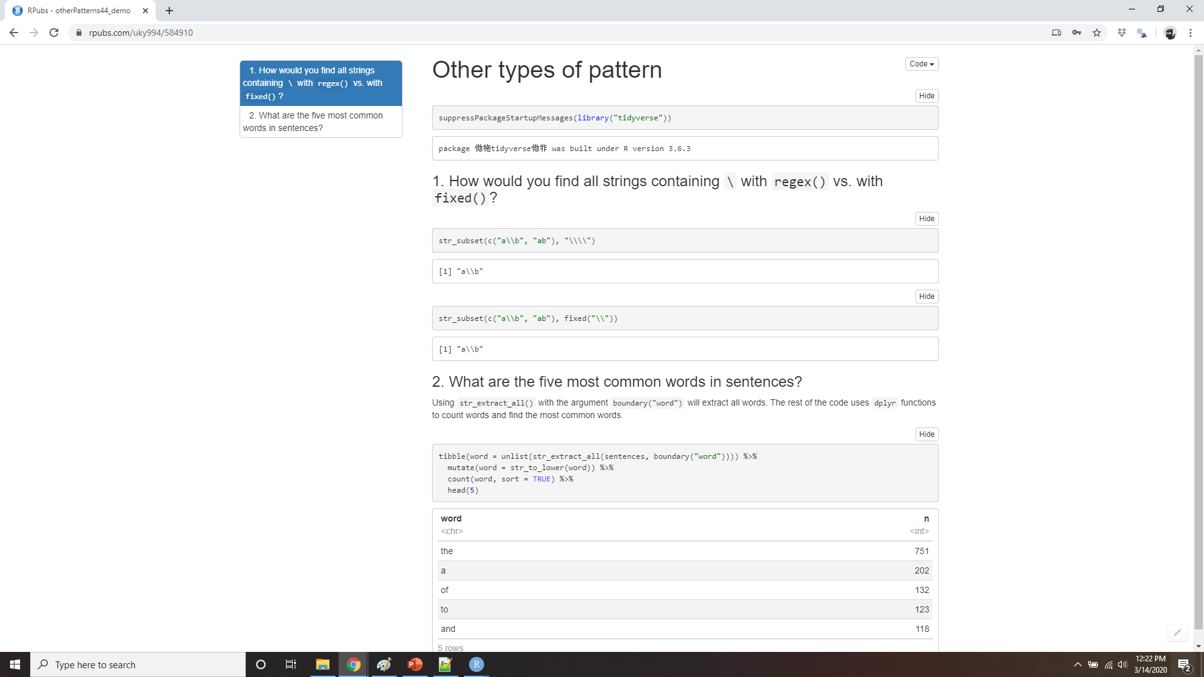
Demo other types of patterns
Notes:
https://rpubs.com/uky994/584910
How would you find all strings containing \ with regex() vs. with fixed()?
What are the five most common words in sentences?

Slide 84
Other uses of regular expressions
There are two useful function in base R that also use regular expressions:
apropos() searches all objects available from the global environment.
dir() lists all the files in a directory.
Notes:
There are two useful function in base R that also use regular expressions:
apropos() searches all objects available from the global environment.
dir() lists all the files in a directory.

Slide 85
apropos()
apropos("replace")
#> [1] "%+replace%" "replace" "replace_na" "setReplaceMethod"
#> [5] "str_replace" "str_replace_all" "str_replace_na" "theme_replace"
Notes:
apropos() searches all objects available from the global environment. This is useful if you can’t quite remember the name of the function.

Slide 86
Dir()
head(dir(pattern = "\\.Rmd$"))
#> [1] "communicate-plots.Rmd" "communicate.Rmd" "datetimes.Rmd"
#> [4] "EDA.Rmd" "explore.Rmd" "factors.Rmd"
Notes:
dir() lists all the files in a directory. The pattern argument takes a regular expression and only returns file names that match the pattern. For example, you can find all the R Markdown files in the current directory with:
(If you’re more comfortable with “globs” like *.Rmd, you can convert them to regular expressions with glob2rx()):

Slide 87
stringi
stringr is built on top of the stringi package.
stringi contains almost every function you might ever need:
stringi has 244 functions
stringr has 49.
Notes:
stringr is built on top of the stringi package. stringr is useful when you’re learning because it exposes a minimal set of functions, which have been carefully picked to handle the most common string manipulation functions. stringi, on the other hand, is designed to be comprehensive. It contains almost every function you might ever need: stringi has 244 functions to stringr’s 49.
If you find yourself struggling to do something in stringr, it’s worth taking a look at stringi. The packages work very similarly, so you should be able to translate your stringr knowledge in a natural way. The main difference is the prefix: str_ vs. stri_.

Slide 88
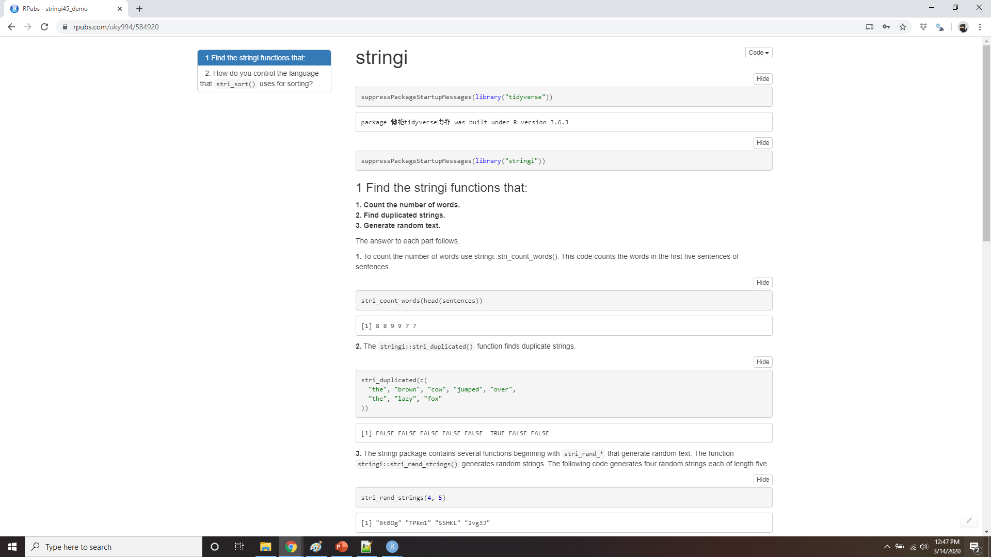
Demo stringi
Notes:
https://rpubs.com/uky994/584920
Find the stringi functions that:
Count the number of words.
Find duplicated strings.
Generate random text.
How do you control the language that stri_sort() uses for sorting?

